Slide 1

PenToPublic
Presented By:
Dinesh Dantal (250245920024)
Supriya Kulkarni (250245920044)
Sahil Kurhe (250245920046)
Amruta Nichale (250245920061)
Piyush Rajhans (250245920061)
Notes:
NOTE:
To change the image on this slide, select the picture and delete it. Then click the Pictures icon in the placeholder to insert your own image.

Slide 2
INTRODUCTION
This project is about building an online book platform that supports both authors and readers.
Authors can publish their books for free in PDF or audiobook format, without going through a complex or expensive process.
Readers can choose how they want to access books — they can read for free, rent for a short time, or buy for lifetime access. Audiobooks can also be used if available.
The platform is designed to be easy to use, flexible, and affordable, making it easier for authors to share their work and more convenient for readers to enjoy books in different formats.

Slide 3
PROBLEM DEFINATION
Traditional publishing is costly and time-consuming for authors.
Many existing platforms are not flexible or user-friendly.
Authors need a free and easy way to publish their work.
There is a need for a platform that is affordable, accessible, and simple to use for both authors and readers.
This project aims to fill the gap by providing a simple, flexible platform that connects authors and readers in an accessible and affordable way.

Slide 4
GOLAS AND OBJECTIVE
🎯 Goal
Simplifies the publishing process for authors
Enhances the reading experience for users
Provides flexible access options and value-added features in a user-friendly environment
✅ Objectives
Free Self-Publishing
Flexible Access for Readers
Audiobook Integration
User-Friendly Interface
Reading Progress Tracking
Secure Payment Gateway
Structured Data Management

Slide 5
SCOPE
Digital self-publishing platform with audio and text book support
Admin-controlled book approval mechanism
Payment tracking and book access history
Reading progress tracking and page-turn simulation
Designed for extensibility and future enhancements
Future Scope
✍️ Integrated Writing Environment
🌟 Book Review System
📨 Author Feedback Portal
🔔 Notification System

Slide 6
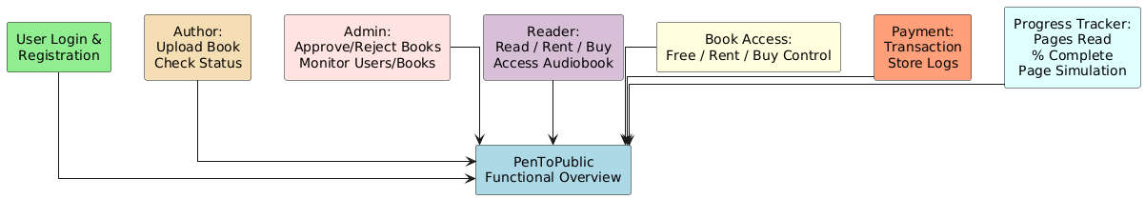
Software Requirement Specification Functional Requirements

Slide 7
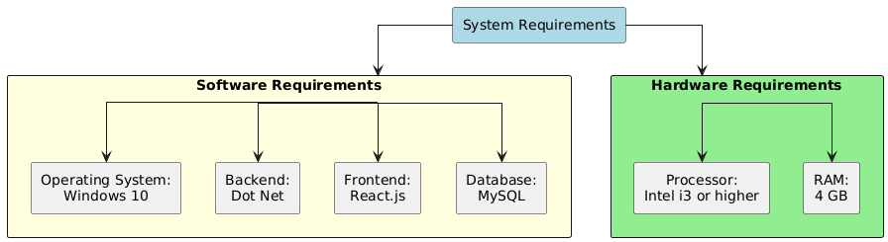

Slide 8
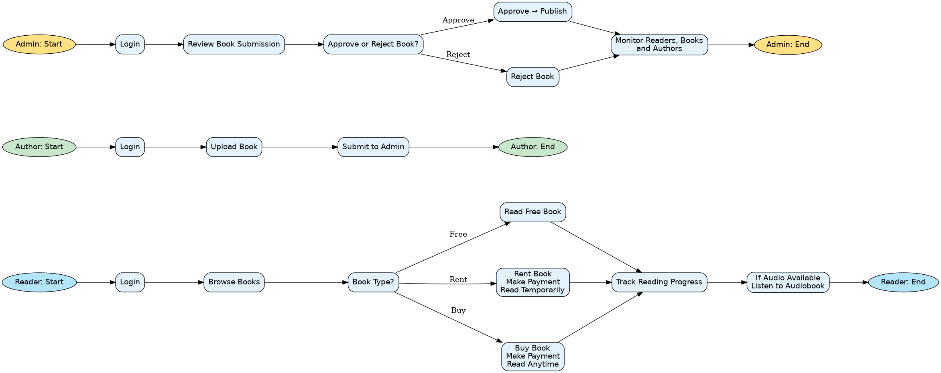
Activity Diagram

Slide 9
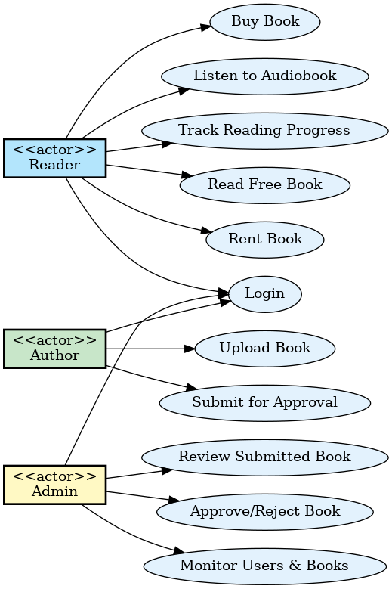
Use-Case Diagram

Slide 10
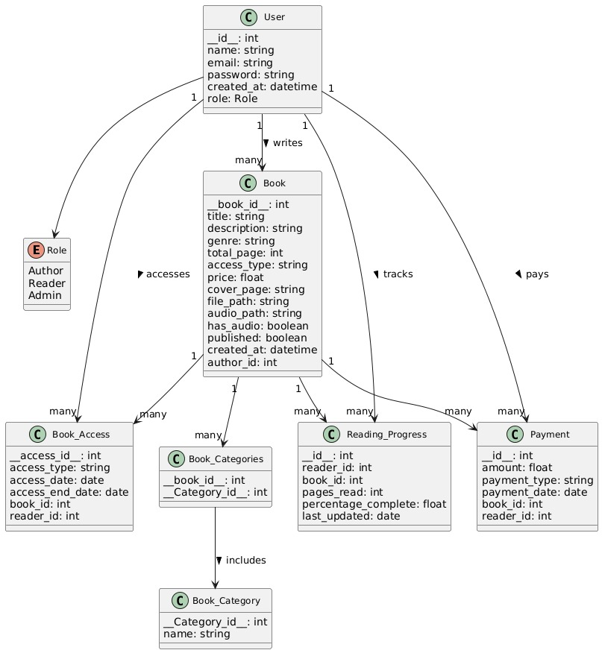
Class Diagram

Slide 11
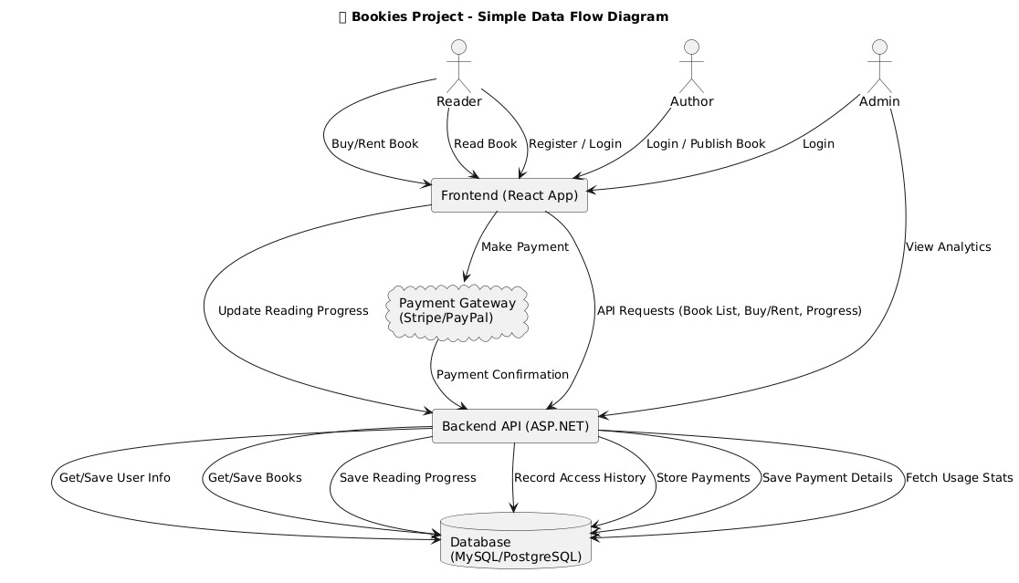
Data Flow Diagram

Slide 12
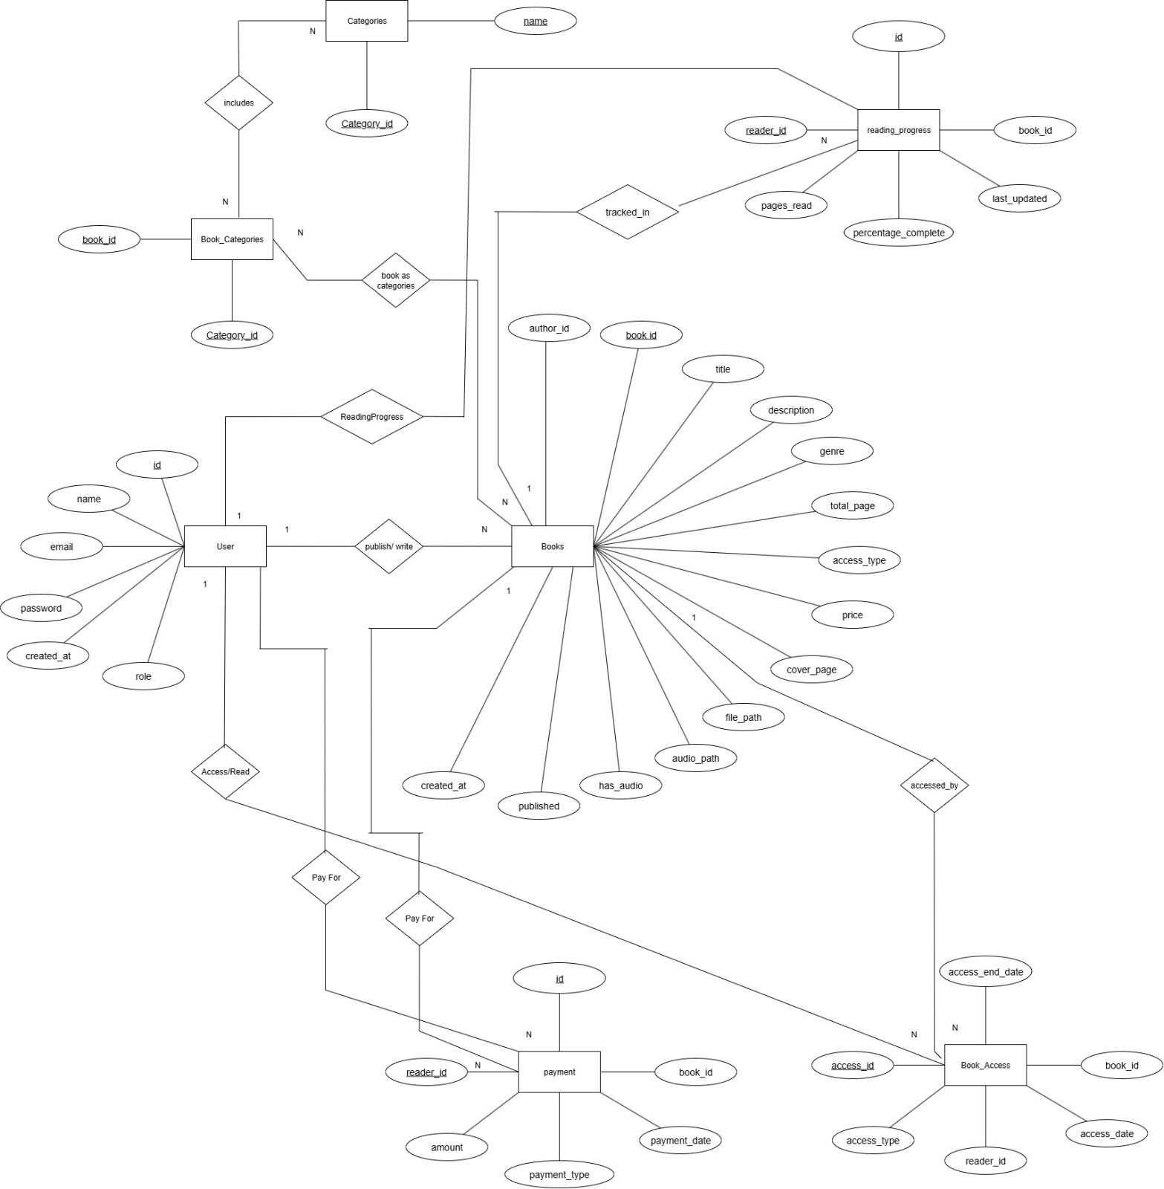
ER Diagram

Slide 13
Thank You

